Slide 1

NLP Project
Shreyak
Notes:
Good Morning everyone, my name is Shreyak and this is my NLP project on Amazon customer review

Slide 2
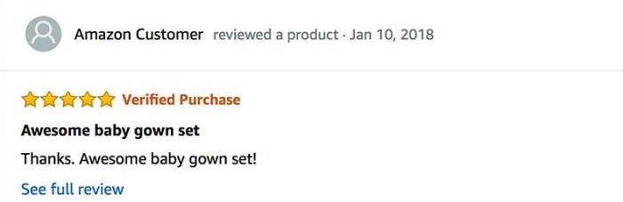
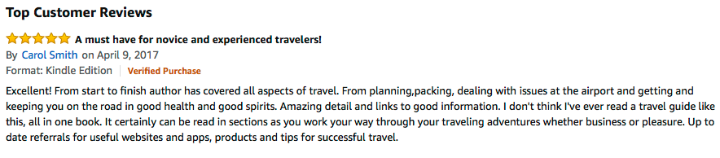
The motivation
The goal
Build a Multi Class Discrete Classifier, which assigns text according to its appropriate rating.
Notes:
i want to talk about my motivation for this project, lets take a look at these reviews for a moment the one on the right is very descriptive and the one on the left is not as the descriptive
These ratings are summarized by a numerical value, or the number of stars. Of course there is more value in the actual text itself than the quantified stars. And at times, the given rating (like the one the left ). does not truly convey the experience of the product – the heart of the feedback is actually in the text itself. The goal therefore is to build a multi class classifier that would understand the essence of a piece of review and assign it the most appropriate rating based on the meaning of the text.

Slide 3
NlP Pre-processing steps
Work with Review Text to create final Dataframe .
Remove Punctuations, Numbers, HTML Entities
Lemmatization (NLTK)
Remove Stop Words, Accents ,Extra Spaces.
Tokenization
Phrase Modelling (Gensim)
Notes:
I am working with review Text to create a final Dataframe , the goal is to produce tokens for each and every review
I started by removing punctuations numbers and HTML entities then I extracted the root words using lamentization , I did this because knowing the frequency of each word is very essential for the next steps
Then I removed stop words, accents ,extra spaces tokenized the corpora
For my fifth step instead of using n gram I created these bigram and tri gram phrases on top of the tokenized corpora because I wanted to work with frequencies instead of just slicing them based on occurance

Slide 4
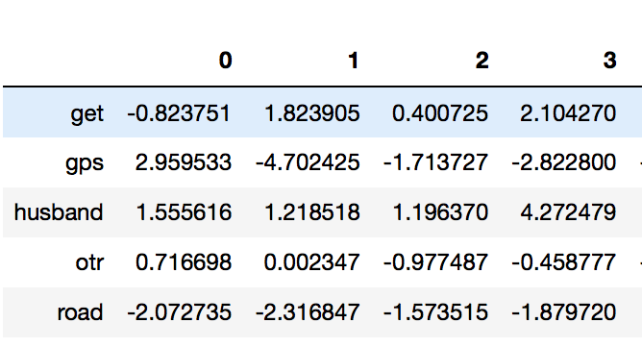
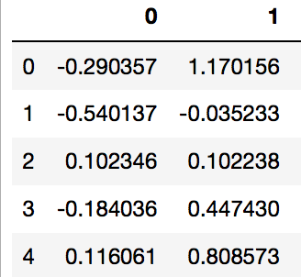
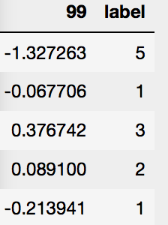
NlP Pre-processing steps
6. Word2vec(Word Embedding)
Created Unique Tokens for each word
7. Singularized Dataframe
Mapped each Word Embedding using Mean
Added Ground Truth for Each Document
MEAN
Notes:
Then I used word2vec to quantify each and every word in our corpora and how often it appears within the vicinity of other words
This Dataframe on the top is mapping all the unique words across all the 100 dimensions \
Then I calculated mean of each of these words and mapped them to where they were in each review what this does is it singularizes multiple word embedding into one observation and then I added ground truth to complete my final Dataframe
So what I am doing here is combing word embeddings into one for that particular review in that particular dimension

Slide 5
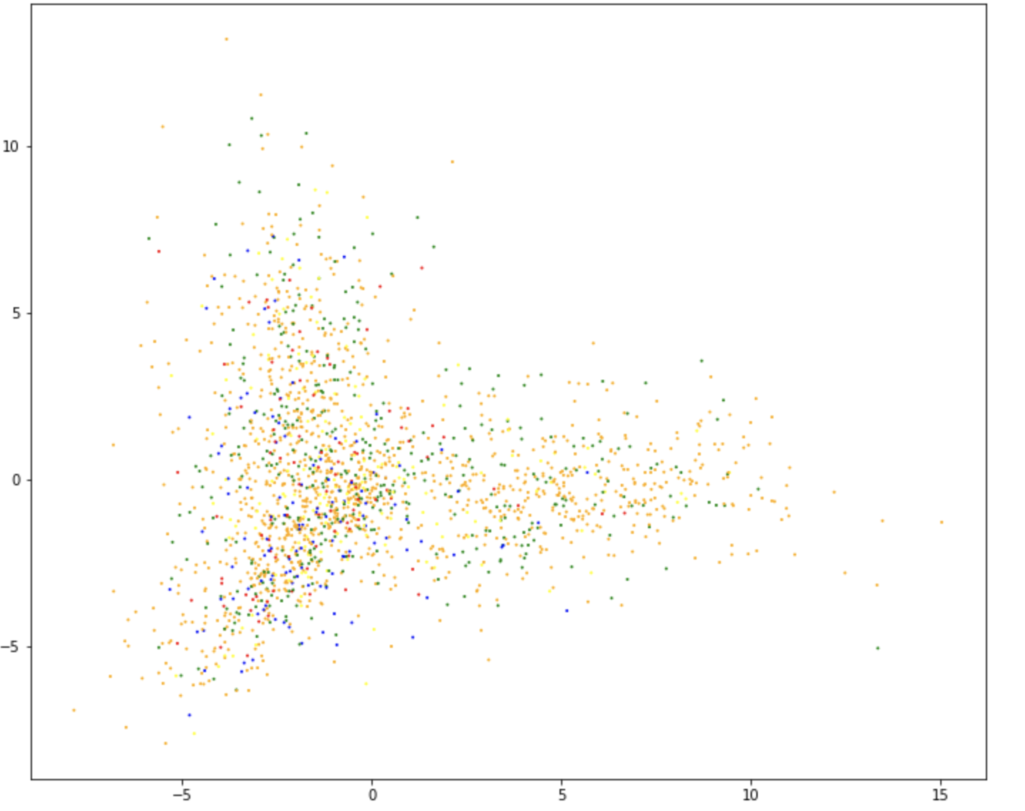
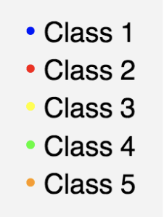
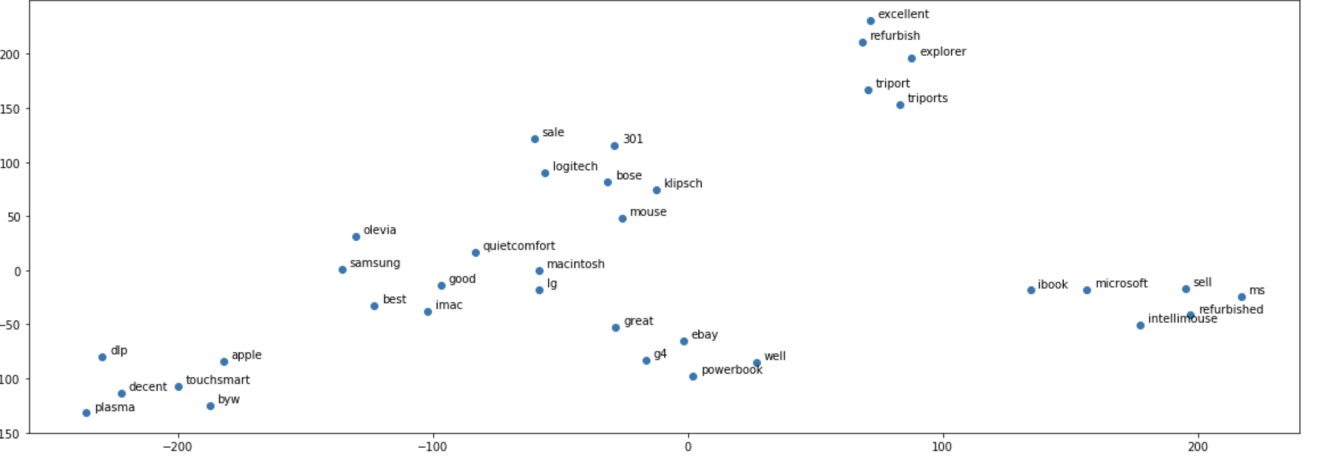
dimensionality reduction
PCA
TSNE
Notes:
I used PCA to convert 100 dimensions to 2 also I wanted to visualize if there is a clear decision boundary along all rating classes but because of the complexity there was no evident decion boundry so I used tsne to understand word similarity on this 2 d plot we can see some clusters here

Slide 6
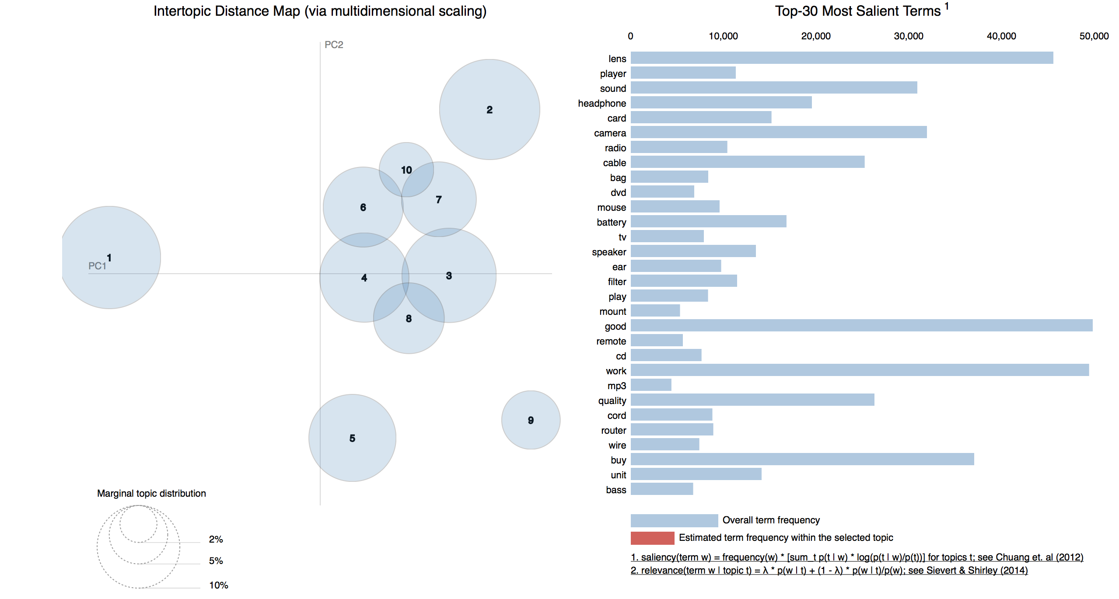
Topic Modeling (using LDA)
Notes:
Here I did some topic modeling to understand and summarize all the latent topics in our corpora

Slide 7
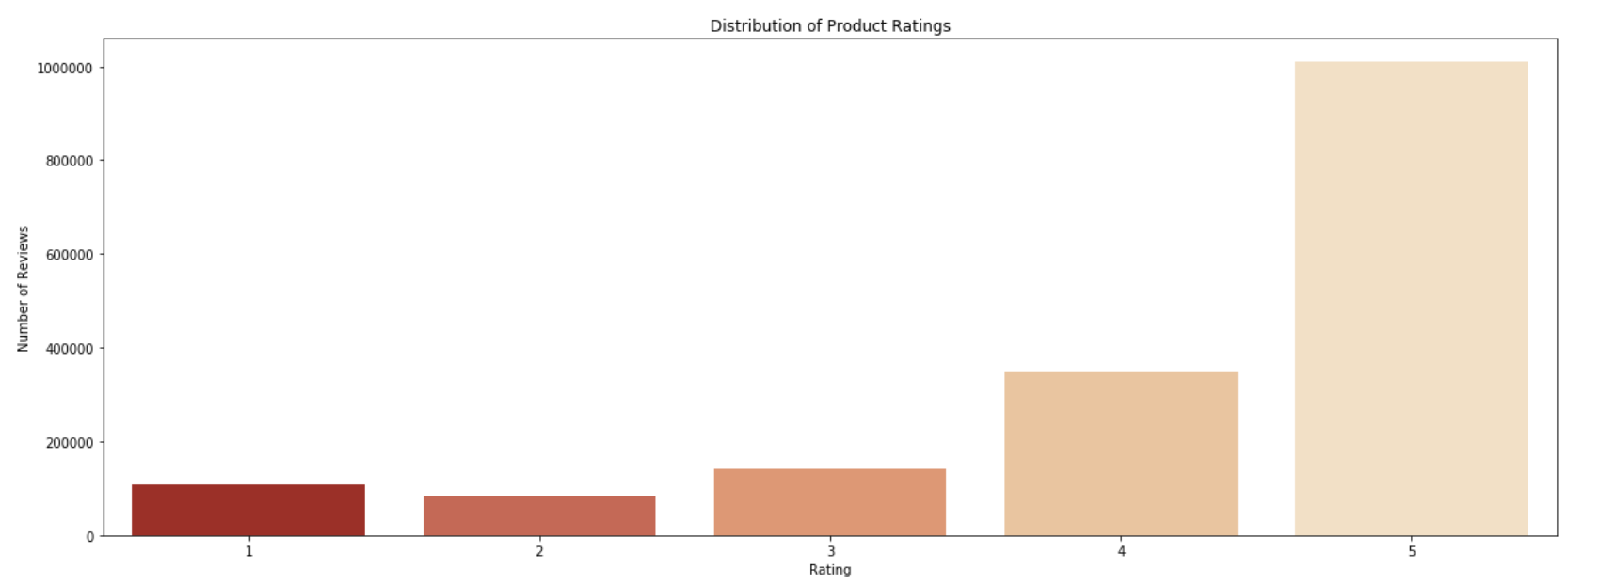
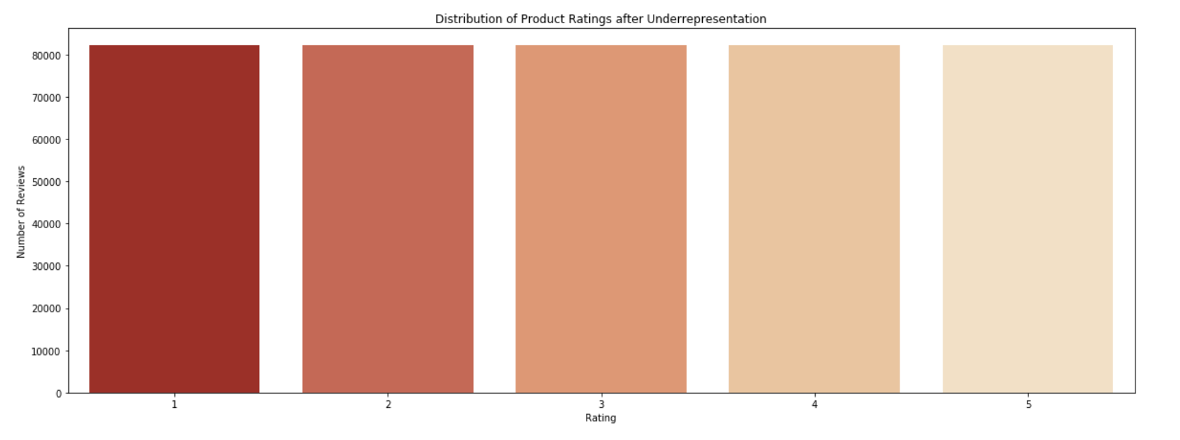
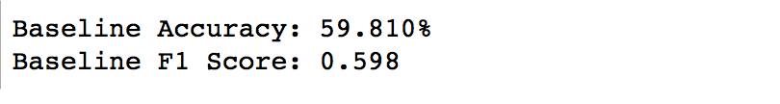
Model Building
Handling imbalanced classes
Choosing Metric
Accuracy
F1 Score
Score for imbalanced Classes
Notes:
Then when I started modeling the first thing I noticed is that the classes are imbalanced so I balanced the classes using smote I chose accuracy and f1 score as my primary metrics beaacuse 1 uneven class distribution and 2 It takes false negatives and false positives both into account the basel ine accuracy here is 59% for the imbalanced classes

Slide 8
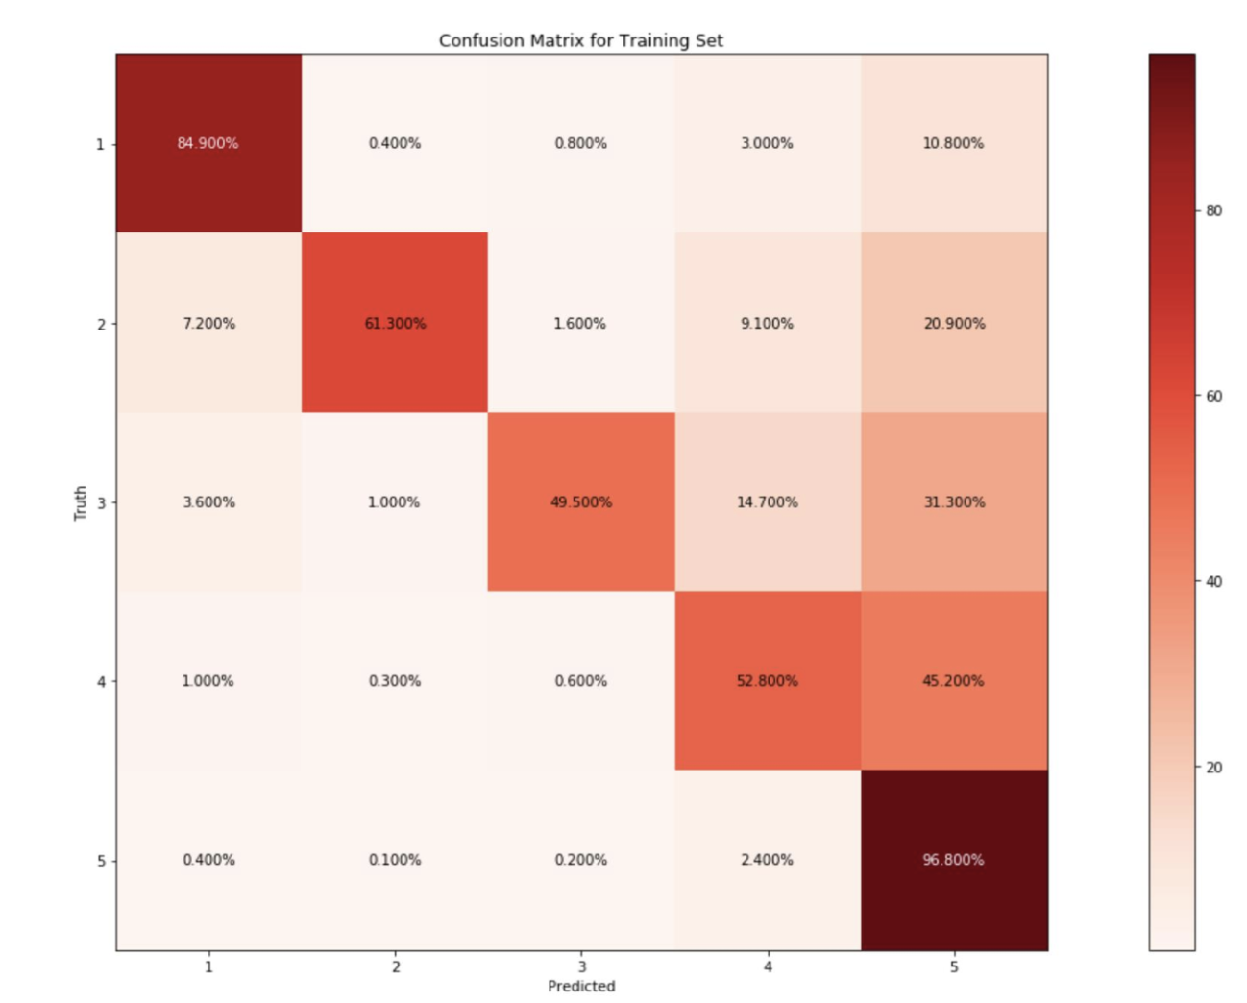

Model Selection, Final Scores
Choosing The Right Model
XG Boost as the preferred model as it out performs others
Tuned XG Boost score(on balanced classes)
Final Score
Notes:
tuned xg Boost outperformed Logistic Regression and Random Forest among other models these here are the final score which is a significant improvement compared to our baseline ,considering the baseline was performed on an imblanced dataset

Slide 9
Conclusion
This model extracts and quantifies text
It Mathematically Measures the Distance between 4 star review and 5 star review
Word Embedding was the central structure of the model
It Answers how far off from a 5 or a 1 star, our review is
Notes:
i want to conculde by saying Various NLP techniques and concepts were explored in this project ●
Though word embedding was central to building the model, pre-processing steps were also extemly crucial
The model actually extracts and quantifies context and therefore the essence of a review by its words make up the final Dataframe
Instead of answering wheather or not this review is helpful this model answers the question how many numbers do I have to move to get to a better or worse review
Essentialy what I am saying is it tells us the precise diffrence between a four start or a 1 star review

